Slide 1
Movie Rating Prediction using RBM
http://www.cs.toronto.edu/~rsalakhu/papers/rbmcf.pdf
Dhruv Khattar - 201402087
Pinkesh Badjatiya - 201402002
Siddhartha Gairola - 201402068

Slide 2
Project Goal
The existing approaches to collaborative filtering are unable to handle huge data sets. So we use a class of 2 layer undirected graphical model called Restricted Boltzmann Machines to model tabular data - which in our case is Movie Ratings given by users. We can use the data sets available on Netflix or IMDB.
From the above we aim to predict the ratings for the movies which have not yet been given a rating by the users.

Slide 3


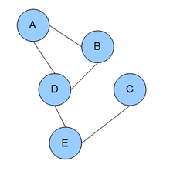
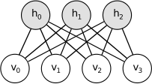
What is RBM, EBM and BM and Bayesian nets?
Energy Based Models
EBM with Hidden units
Boltzmann machine or a undirected graphical model, is a set of random variables having a Markov property
RBM: restrict BMs to those without visible-visible and hidden-hidden connections.

Slide 4
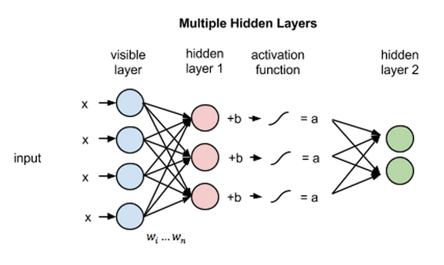
RBM vs Neural Networks
RBMs are shallow, two-layer neural nets that constitute the building blocks of deep-belief networks.
The 1st layer of the RBM is called the visible, or input, layer, and the second is the hidden layer.

Slide 5
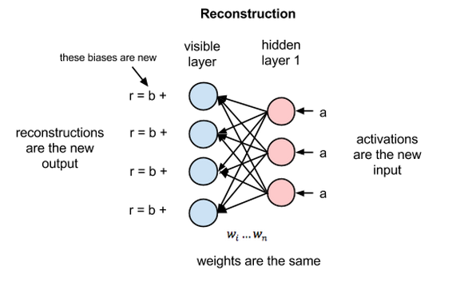
Reconstruction in RBM’s
How do they perform better without involving a deeper network?
Reconstruction estimates a continuous value based on many inputs and makes guesses about which discrete label to apply to a given input.

Slide 6
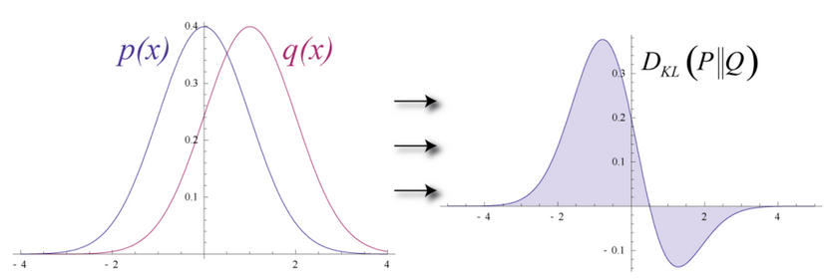

Slide 7
Steps and methods we will be using.
Restricted Boltzmann Machines
RBM’s with Gaussian Hidden Units
Conditional RBM’s
Conditional Factored RBM
Python
numpy

Slide 8
Dataset Available to us
Netflix dataset from 1998 to 2005
3 types of data
Training data: 100M ratings from 480k users randomly chosen on 18k movies.
Validation data: Containing 1.4M ratings.
*Test data*: Has 2.8M user/movie pairs without any rating.
https://web.archive.org/web/20090925184737/http://archive.ics.uci.edu/ml/datasets/Netflix+Prize

Slide 9
How we proceed?
A low dimensional feature vector is assigned to each user and a low dimensional feature vector to each movie so that the rating each user assigns to each movie is modeled by the scalar-product of the 2 feature vectors. -
This means that the N × M matrix of ratings that N users assign to M movies is modeled by the matrix X which is the product of an N × C matrix U whose rows are the user feature vectors and a C × M matrix V whose columns are the movie feature vectors. The rank of X is C the number of features assigned to
each user or movie.

Slide 10
Restricted Boltzmann Machines
Why we use RBM? - Low-rank approximations based on minimizing the sum-squared distance can be found using SVD(singular value Decomposition). But in collaborative filtering domain, most of the data sets are sparse and this creates a complex non-convex problem. Thus we use RBM.
If we have M movies, N users and integral ratings from 1-K.
If all N users rated the same set of M movies then we just use a single training case for an RBM which has M softmax visible units symmetrically connected to a set of binary hidden units.

Slide 11
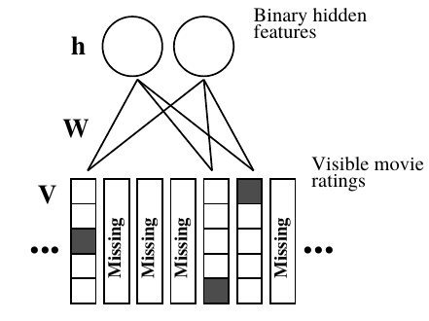
But in case of lot of ratings missing, we model a different RBM for each user.
Every RBM has the same number of hidden units, but an RBM only has visible softmax units for the movies rated by that user, so an RBM has few connections if that user rated few movies. Each RBM only has a single training case, but all of the corresponding weights and biases are tied together, so if two users have rated the same movie, their two RBM’s must use the same weights between the softmax visible unit for that movie and the hidden units.

Slide 12

Learning
Contrastive Divergence
To avoid computing <·>model, we follow an approximation to the gradient of a different objective function called CD.
Expectation <.>T represents a distribution of samples from running the Gibbs sampler.

Slide 13

Making Predictions
Given the observed ratings V, we can predict a rating for a new query movie q in time linear in the number of hidden units:
pick the rating with the maximum score as our prediction, or perform normalization over K values.

Slide 14
Alternative Methods
ALS
Matrix Factorization
Gradient Descent
Auto Encoders

Slide 15
Tasks done uptil now -
Implemented a simple rbm with binary hidden units.
Modified the rbm to suit our model.
Data Handling - Extracted the data from the netflix dataset and have made a dictionary for every user and the movies he has rated with their respective ratings.

Slide 16
Our Model
The visible layer consists of x units where x is the number of movies a particular user has rated.
Each unit in the visible layer is a vector of length 5 ( since ratings are from 1 to 5), and the ith index is one corresponding to the rating the user has given, the rest are zeros.
The hidden layer consist of 100 units which are binary.
The activation function we have used is the sigmoid function both for forward propagation and backward propagation.

Slide 17
Results
The rbm implemented is converging and the error value goes to 0.

Slide 18
Task Remaining
Implementing the predictor and verifying the values.
Further modifying the current model to make RBM’s with Gaussian Hidden Units.
Trying to increase the efficiency of the model.

Slide 19
THANK YOU :)

